Slide 1






Project:
Internship IU
created by Trần Hải Nam-ITITIU19161

Slide 2

1
Introduction
Table of content
2
Analysis
3
Deploy and demo

Slide 3
Introduction

Slide 4
Problem of Student
Difficulty in obtaining information about the internship process
Difficulty in finding work with reputable companies
Difficulty finding report templates and submitting reports to teachers
It's hard not knowing how to write a cv and how to submit it

Slide 5
Problem of Teacher
Takes time in compiling student information for grading and reporting
Difficulty in student management and student support

Slide 6
Analysis

Slide 7
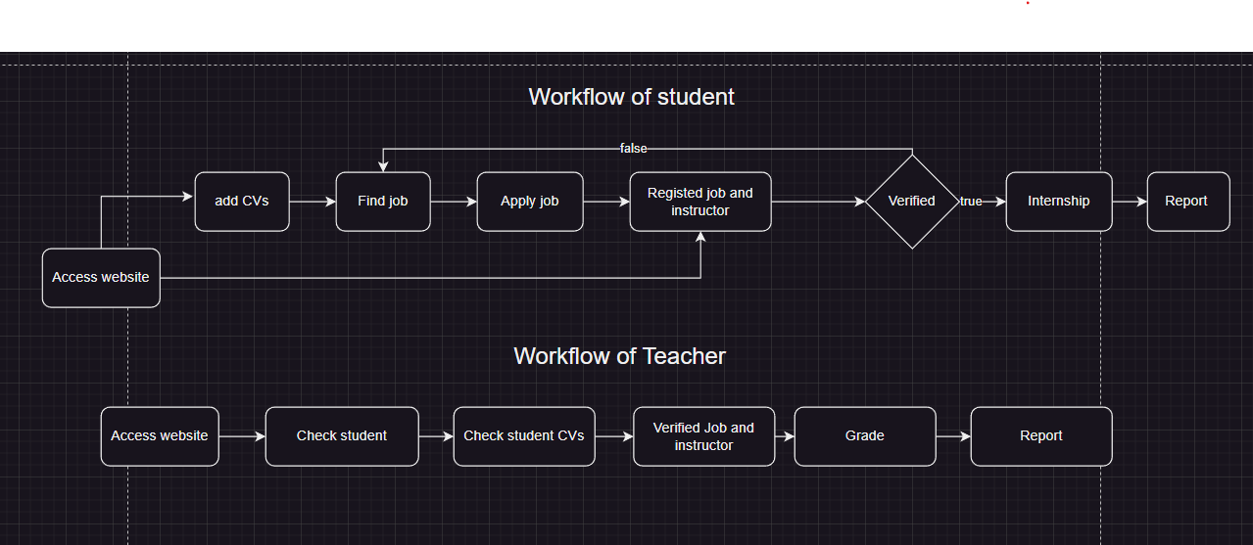
Workflow

Slide 8
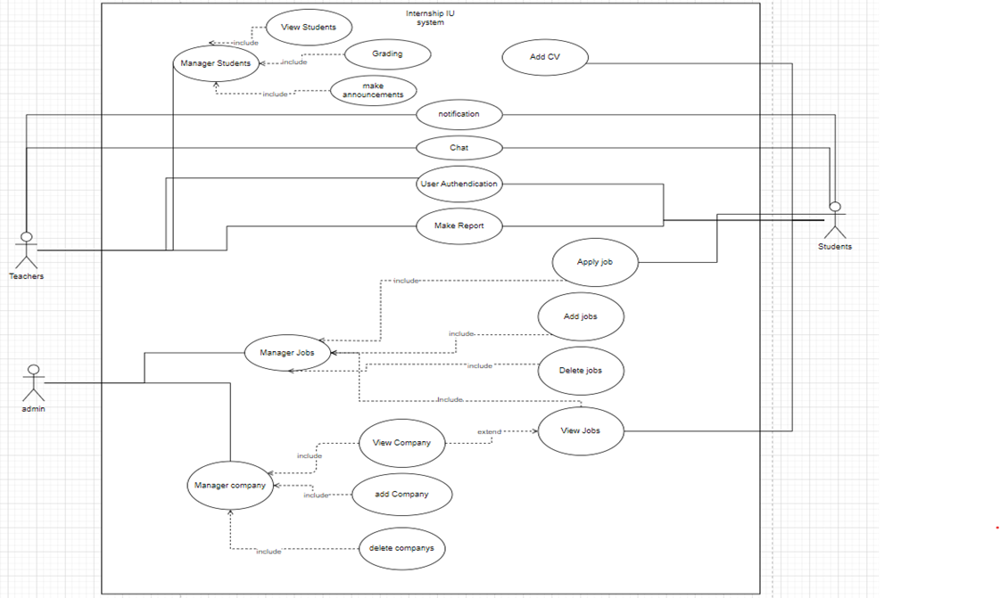
Usecase diagram

Slide 9
Deploy and Demo

Slide 10


Technical
Mui Material UI
Reactjs

Slide 11
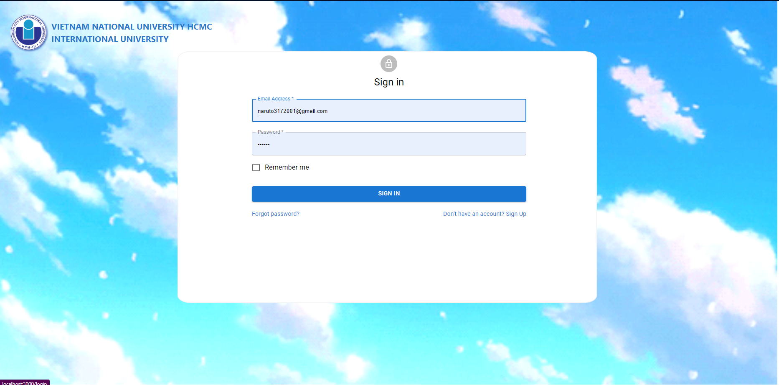
Demo

